Slide 1
A Linear Regression Analysis of Predictors of Overall Survival Among Breast Cancer Patients in the METABRIC Dataset
Presented by: Daniel Oluwafemi Olofin Statistical Data Analysis (STAT 5660G)
Department of Mathematical Sciences,
Georgia Southern University.

Slide 2
Abstract:
Motivation: I chose to work with breast cancer data because my long-term goal of developing and applying statistical and machine-learning methods to improve clinical decision-making in oncology.
This study applied a multiple linear regression model to the METABRIC breast cancer dataset to identify key clinical, molecular, and treatment predictors of overall survival. After data cleaning and selection, 1,815 complete patient records were analyzed using variables such as Age at Diagnosis, Tumor Size, Lymph Nodes Examined Positive, ER Status, HER2 Status, ChemoThis study applied a multiple linear regression model to the METABRIC breast cancer dataset to identify key clinical, molecular, and treatment predictors of overall survival. After data cleaning and selection, 1,815 complete patient records were analyzed using variables such as Age at Diagnosis, Tumor Size, Lymph Nodes Examined Positive, ER Status, HER2 Status, Chemotherapy, and Hormone Therapy. Stepwise AIC selection produced a parsimonious model with strong clinical relevance. Ten-fold cross-validation yielded an average RMSE of 70.81 months and R² of 0.137, while the test set produced RMSE = 70.38 months and R² = 0.154, indicating moderate predictive performance. Diagnostic checks confirmed that all linear regression assumptions were met. The findings highlight age, tumor burden, lymph node involvement, and receptor status as major factors influencing survival, consistent with established clinical evidence therapy, and Hormone Therapy. Stepwise AIC selection produced a parsimonious model with strong clinical relevance. Ten-fold cross-validation yielded an average RMSE of 70.81 months and R² of 0.137, while the test set produced RMSE = 70.38 months and R² = 0.154, indicating moderate predictive performance. Diagnostic checks confirmed that all linear regression assumptions were met. The findings highlight age, tumor burden, lymph node involvement, and receptor status as major factors influencing survival, consistent with established clinical evidence.
Introduction: Female breast cancer has surpassed lung cancer as the most commonly diagnosed cancer worldwide, with an estimated 2.3 million new cases (11.7%), followed by lung (11.4%), colorectal (10.0%), prostate (7.3%), and stomach (5.6%) cancers (Sung et al., 2021).

Slide 3
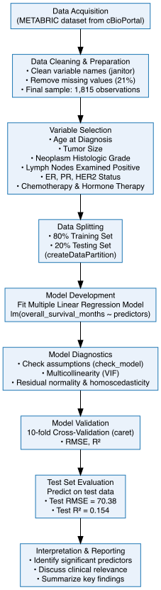
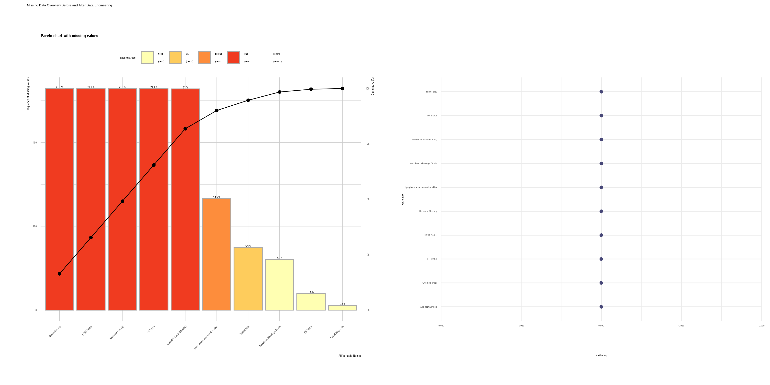
Visualization Missingness

Slide 4
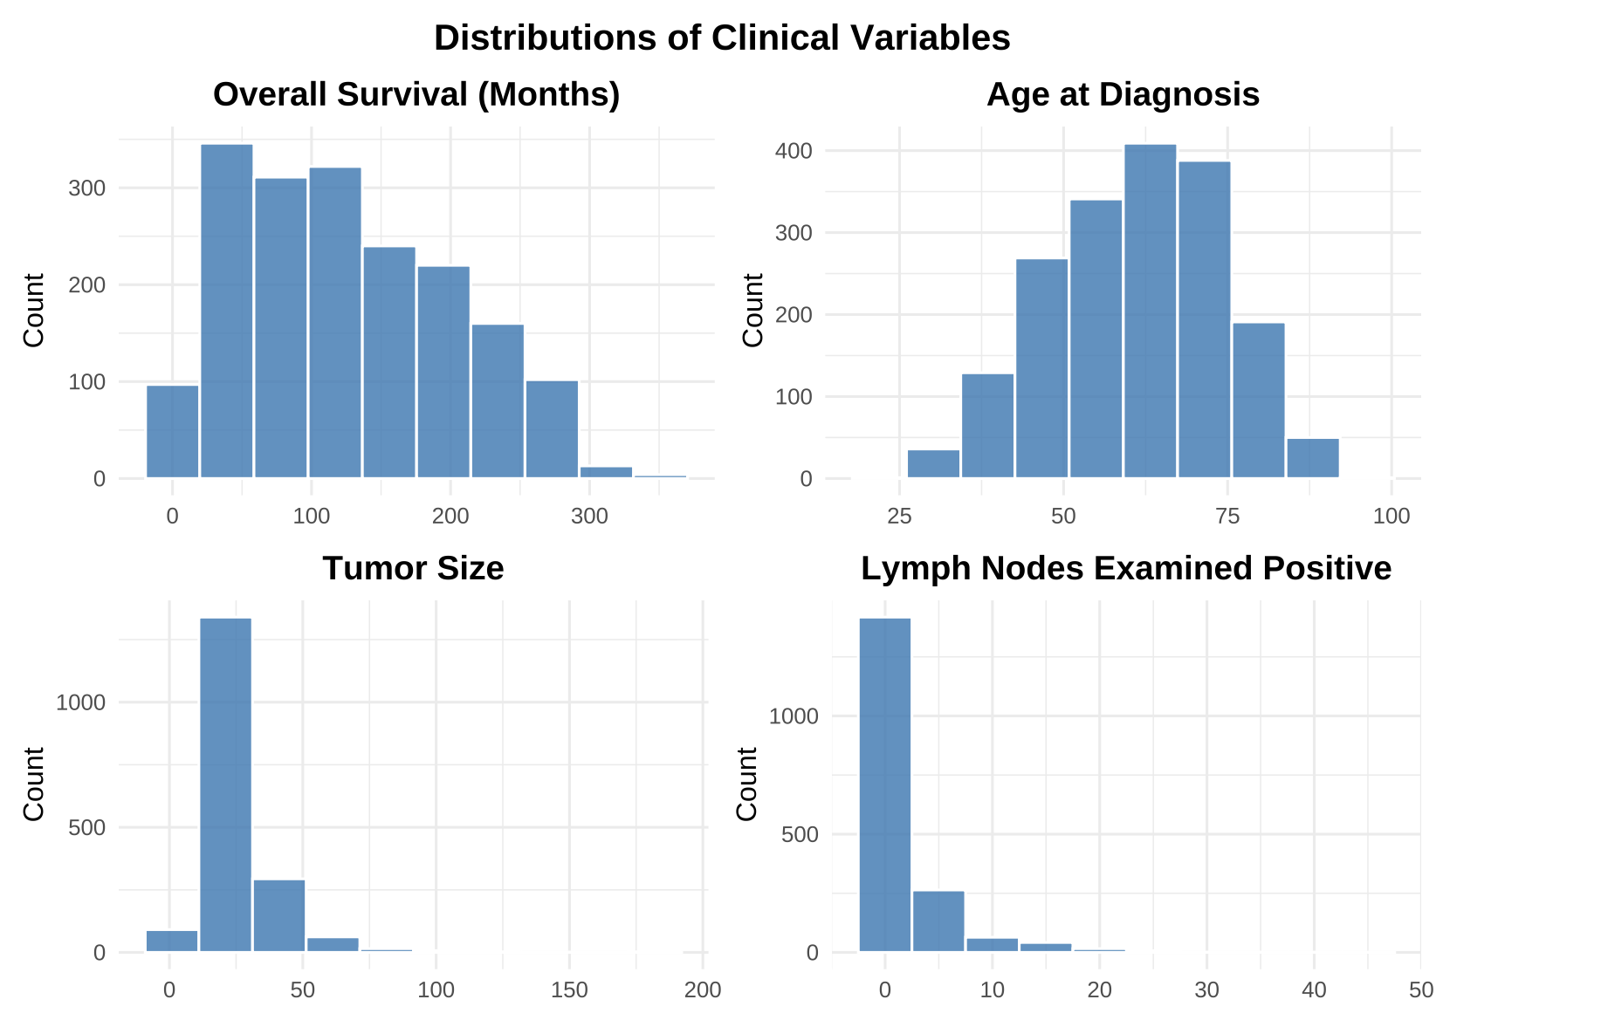
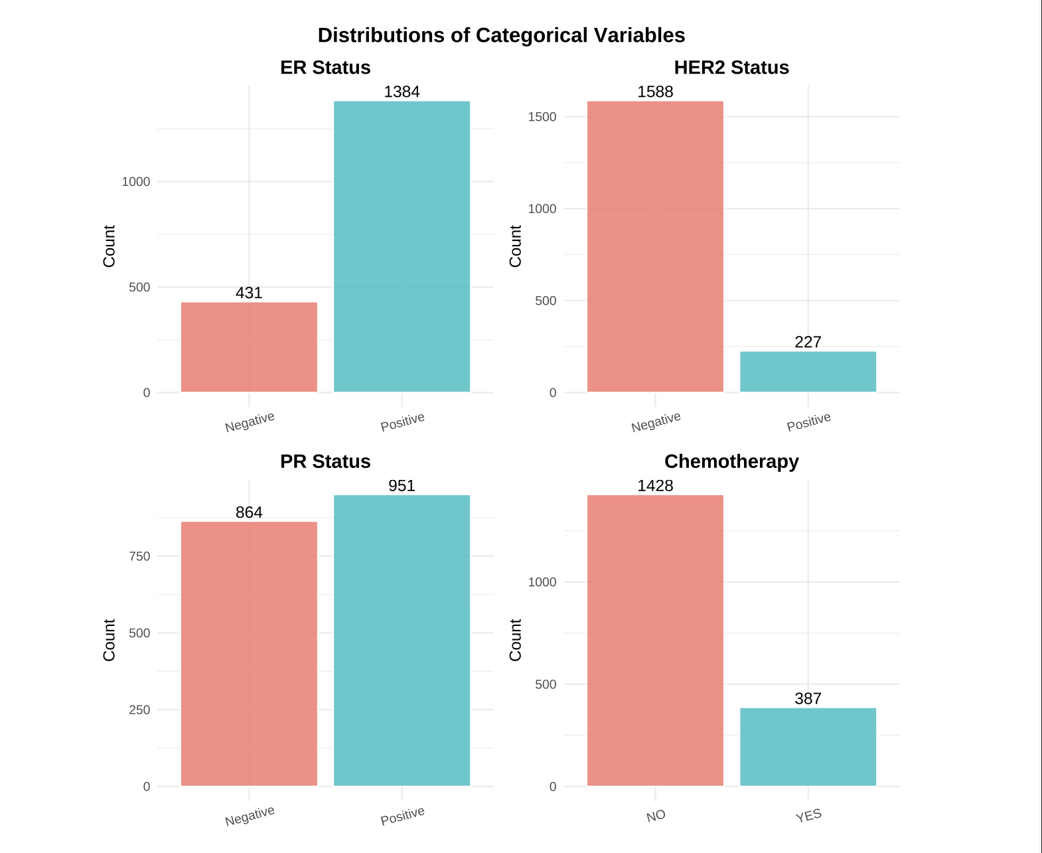
Data visualization:

Slide 5
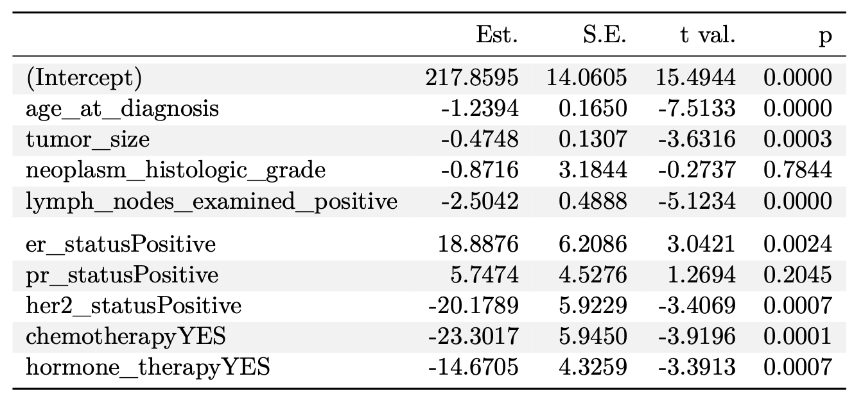
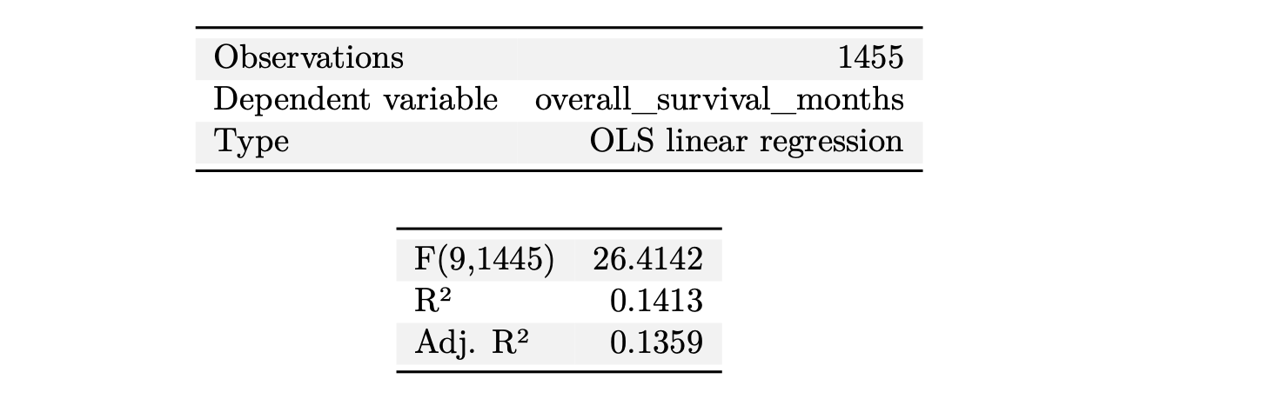
Modeling:
OS (Months) = β₀ + β₁(Age) + β₂(Tumor Size) + β₃(Grade) + β₄(Lymph Nodes +) + β₅(ER) + β₆(PR) + β₇(HER2) +
β₈(Chemo) + β₉(Hormone Tx)

Slide 6
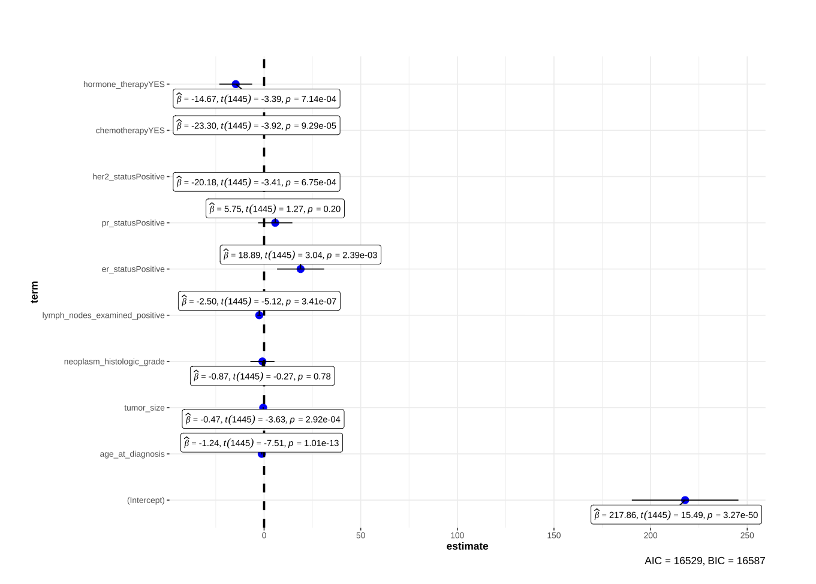
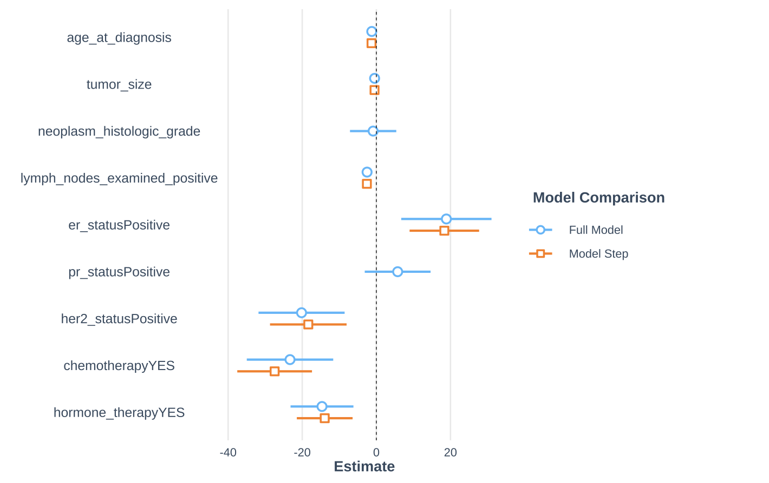
Selection Model for Predictor and comparative Model between full and half model:

Slide 7

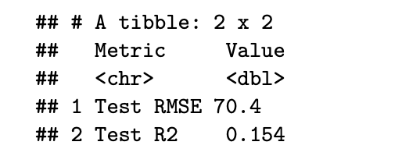
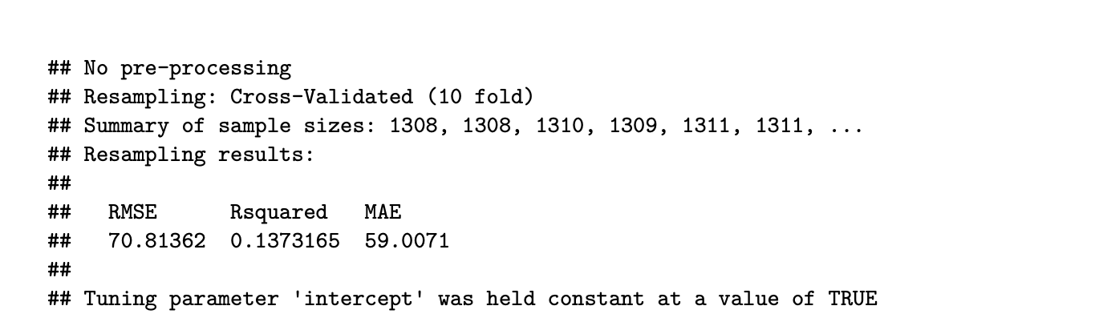
Model Performance and Test Evaluation:
M
Test Evaluation:
The model’s performance was tested on unseen data to assess generalization. The test set results show a Root Mean Square Error (RMSE) of 70.38 months and an R-squared R² value of 0.154. This means the model explains about 15.4% of the variation in overall survival among patients in the test data.
The 10-fold cross-validation results indicate that the linear regression model performed consistently across all folds, using 1,455 samples and 7 predictors.

Slide 8
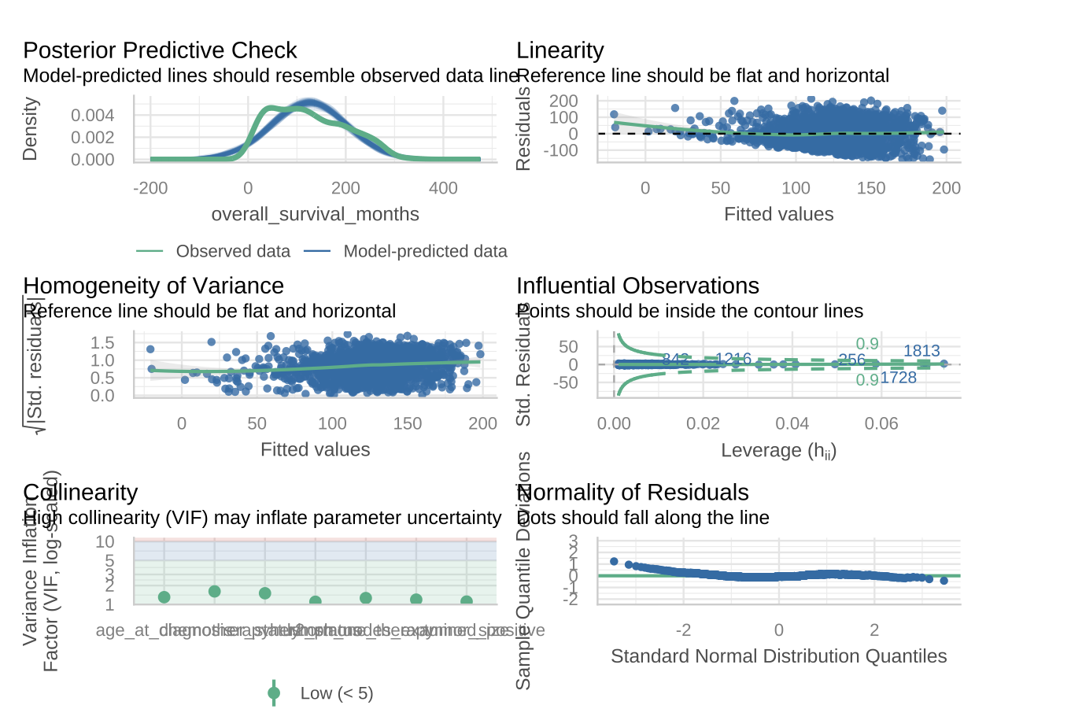
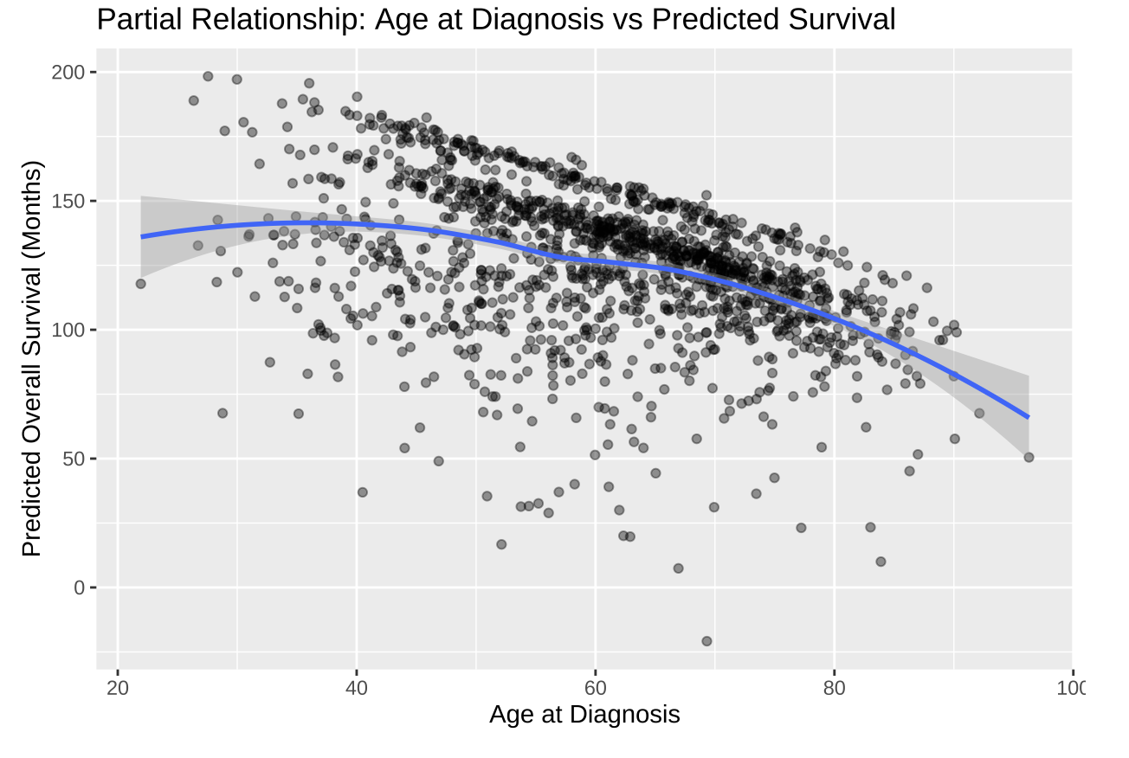
Model Diagnostics and Top Numerical Prediction:
Prediction:

Slide 9
Project II: Comparative Analysis of Logistic Regression and Random Forest Models for Predicting Breast Cancer Survival Status: Evidence from the METABRIC Dataset
Abstract:
Accurate prediction of breast cancer survival outcomes is critical for guiding clinical decision-making and improving patient care. This study compares the performance of two supervised learning algorithms—Logistic Regression and Random Forest—using the METABRIC breast cancer dataset. Logistic Regression, a linear classifier commonly used for clinical interpretation, achieved limited predictive performance, with an accuracy of 31%, low sensitivity, and a negative Kappa statistic, indicating poor agreement beyond chance. These results suggest that the linear decision boundary inherent to logistic regression is insufficient for modeling the complex, nonlinear relationships typical in high-dimensional biomedical data. In contrast, the Random Forest classifier demonstrated substantially stronger predictive capacity, achieving an accuracy of 70%, sensitivity of 78%, and improved specificity. Its higher balanced accuracy and positive Kappa statistic highlight its robustness in capturing nonlinear interactions and heterogeneous patient patterns present in the dataset.
Aim: To develop and compare Logistic Regression and Random Forest classification models for predicting breast-cancer survival status using clinically and molecularly relevant variables from the METABRIC dataset.
Objectives
- Identify and select clinically relevant predictors of overall survival status from the METABRIC dataset.
- Develop a Logistic Regression model to estimate the probability of patient survival outcomes.
- Develop a Random Forest model to evaluate nonlinear relationships and improve predictive accuracy.
- Compare both models based on key performance metrics such as Accuracy, AUC, and Confusion Matrix results.
- Interpret the findings in the context of clinical relevance and discuss implications for breast-cancer prognosis and treatment decision-making.

Slide 10
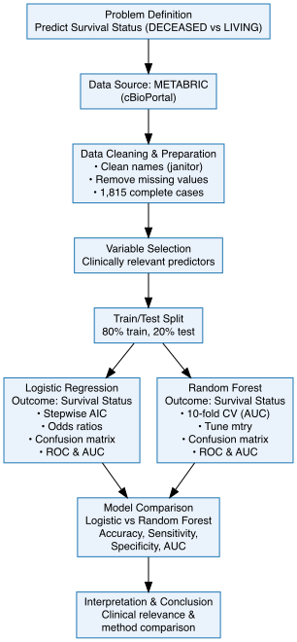
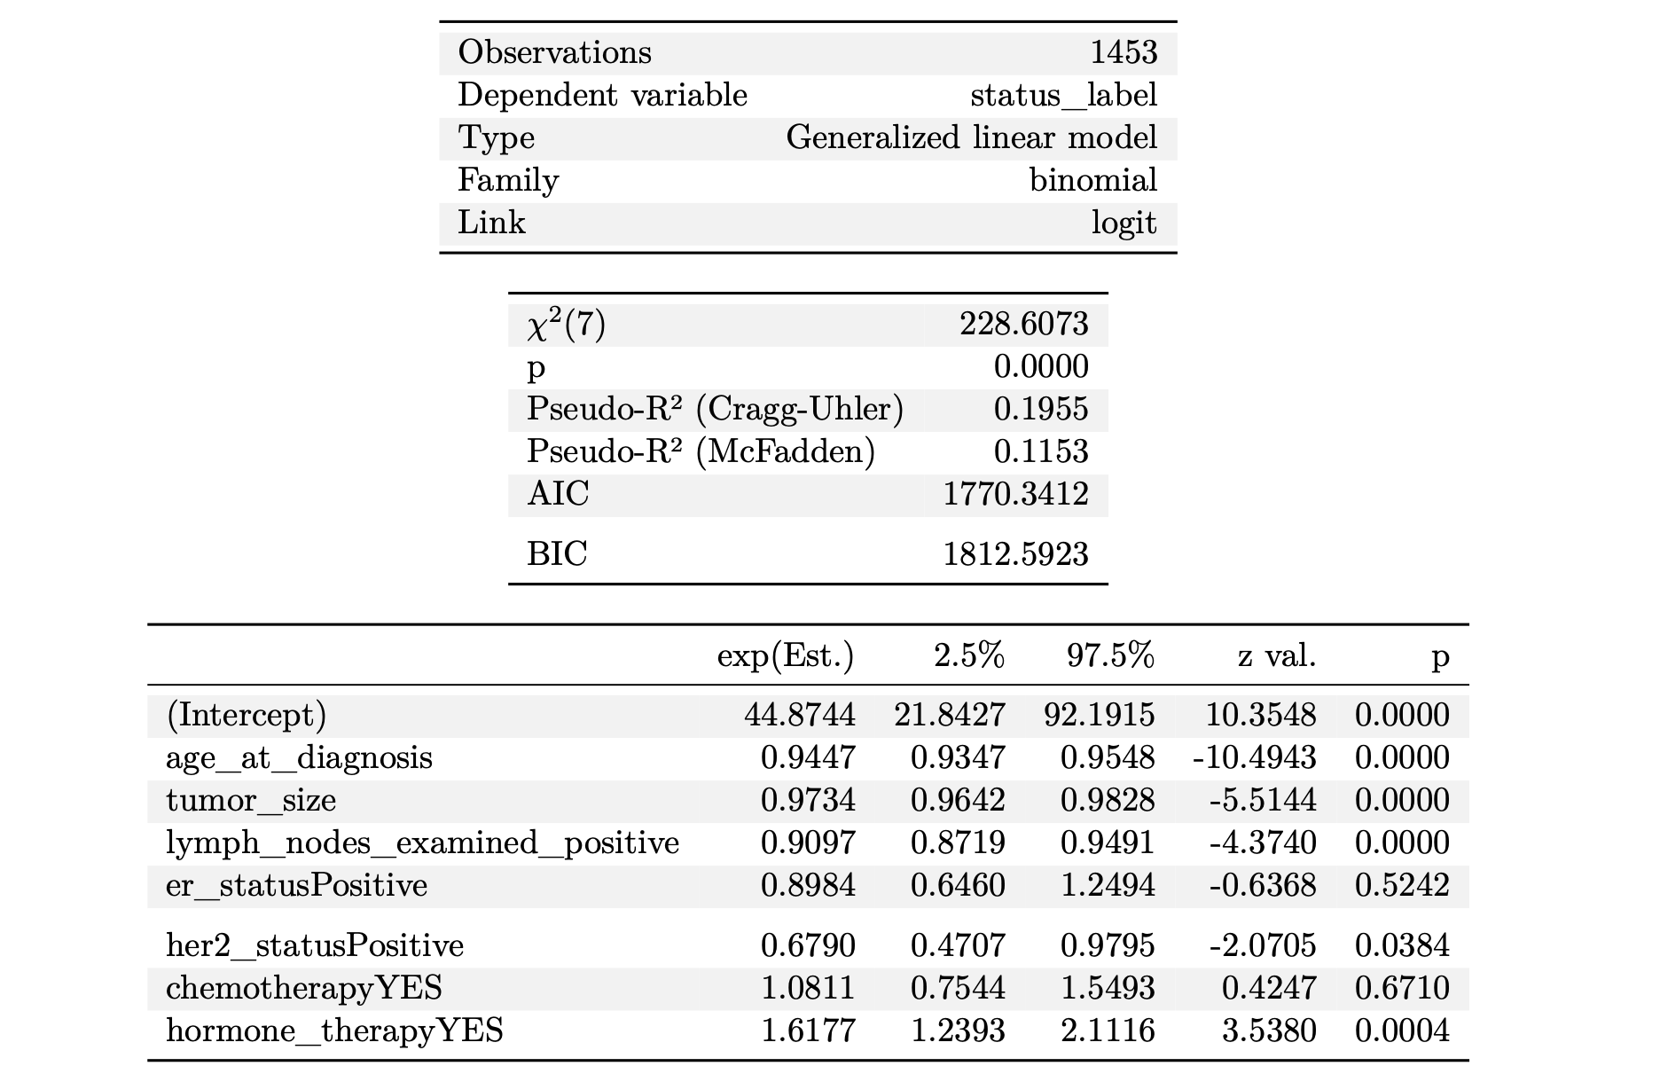
logit(pᵢ) = β₀ + β₁(Age) + β₂(Tumor Size) + β₃(Lymph Nodes+) + β₄(ER) + β₅(HER2) + β₆(Chemo) + β₇(Hormone Tx)
Logistic Model Result:

Slide 11
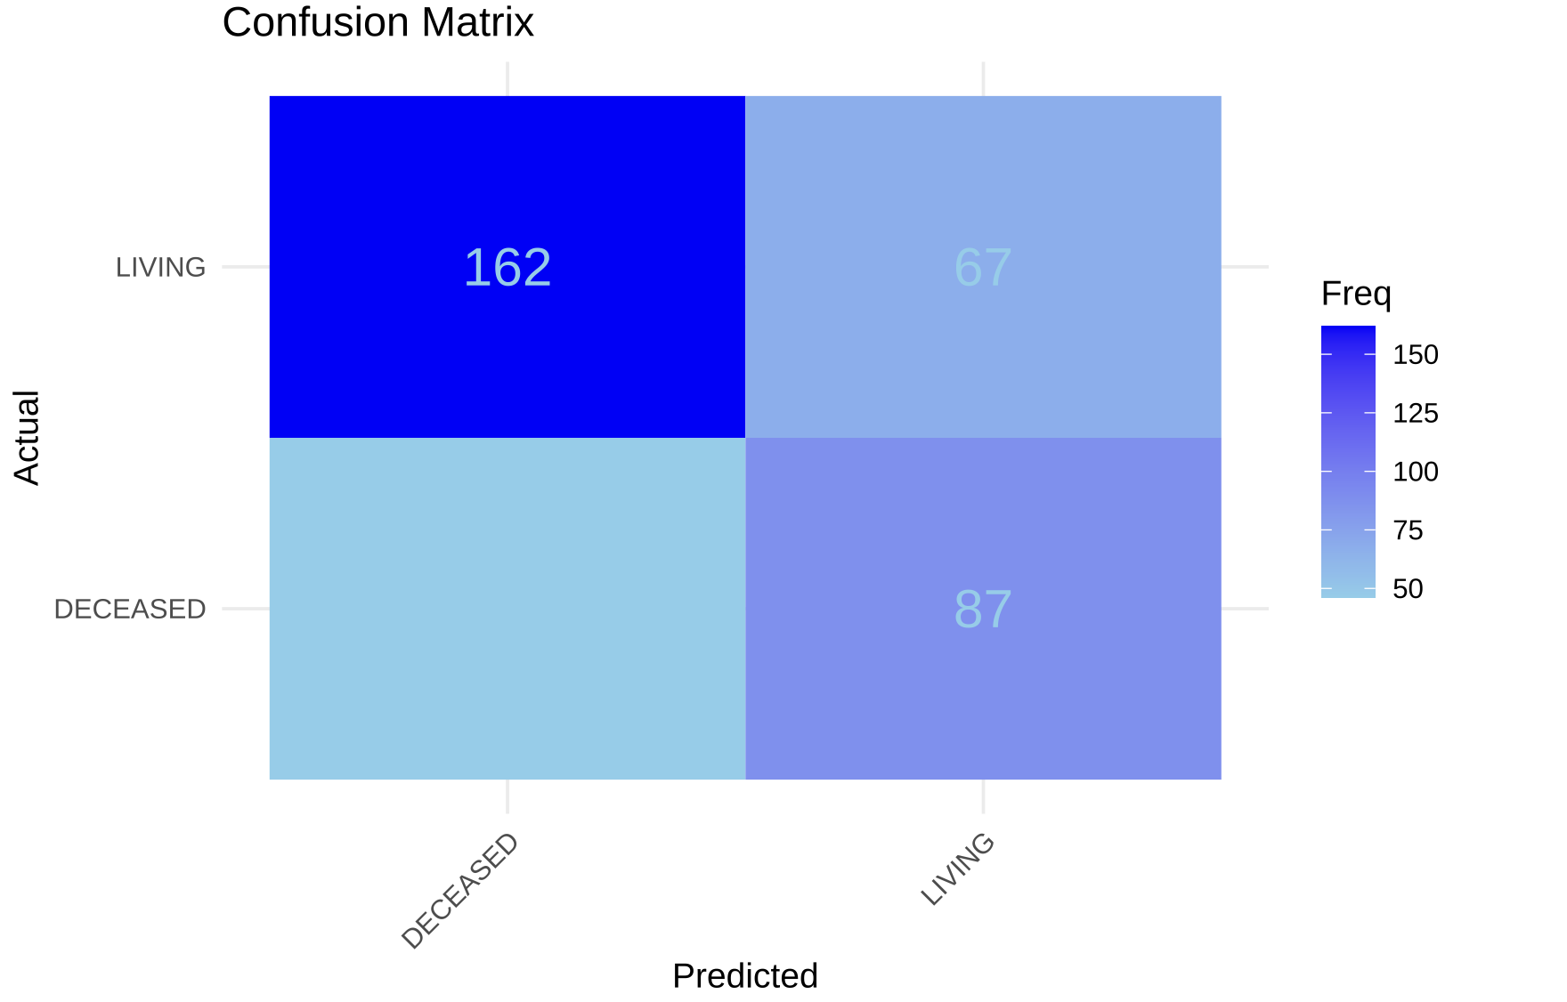
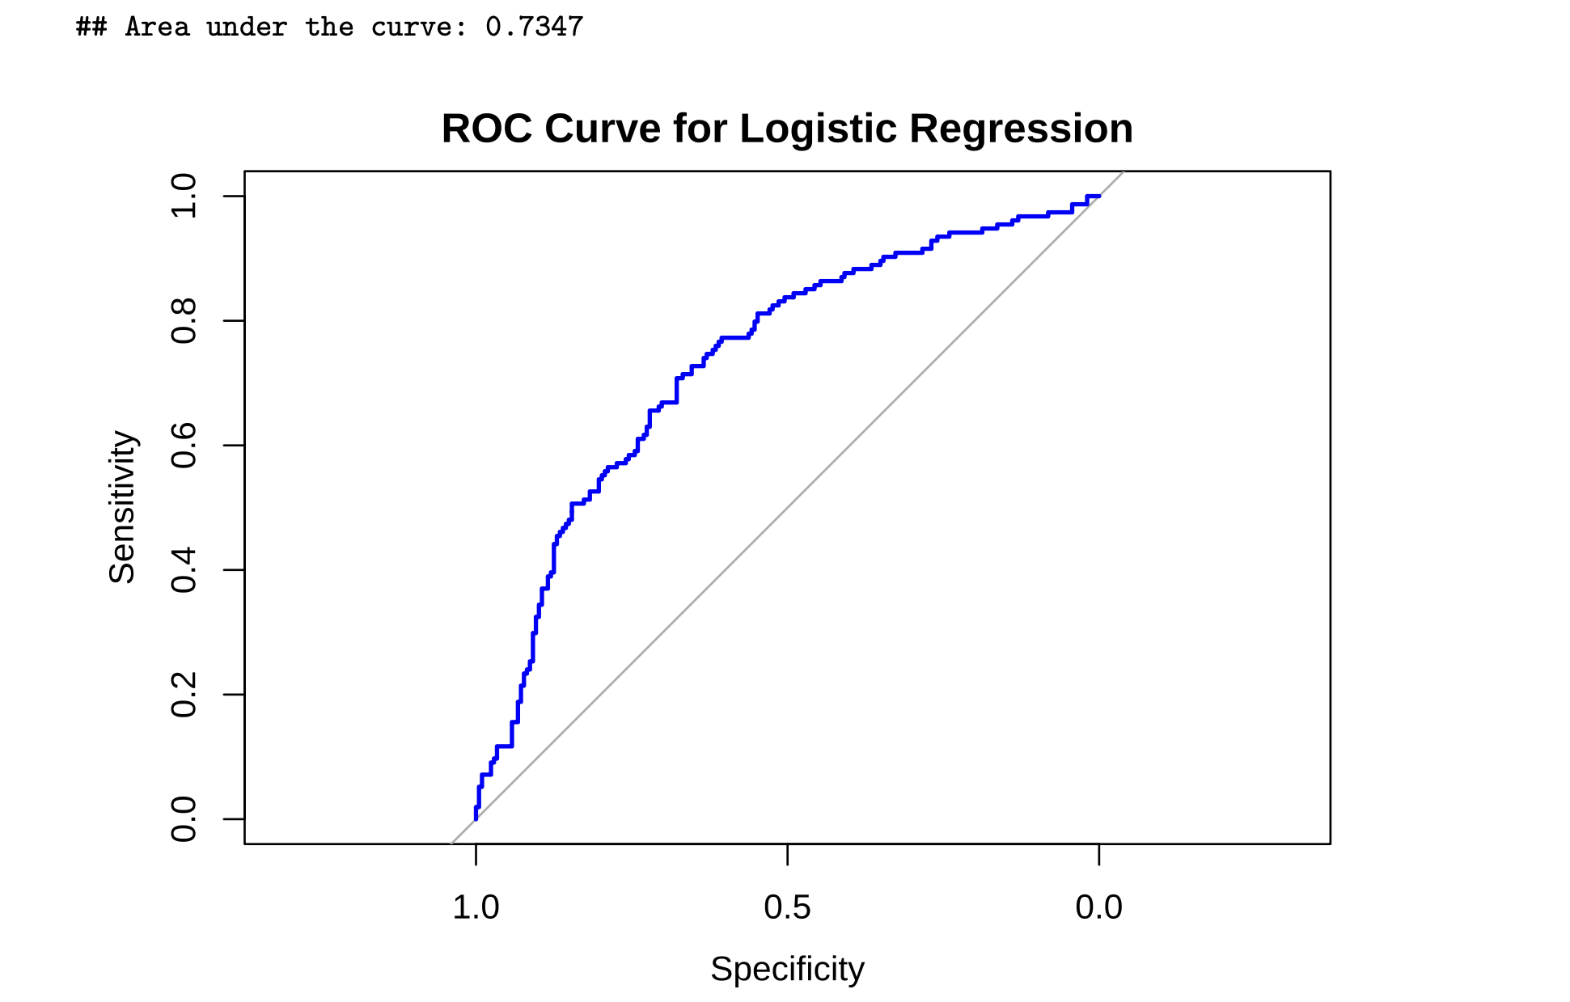
- Accuracy: 30.9%, Sensitivity (Detecting DECEASED): 22.1%
- Specificity (Detecting LIVING): 42.9%
- Balanced Accuracy: 32.5%

Slide 12
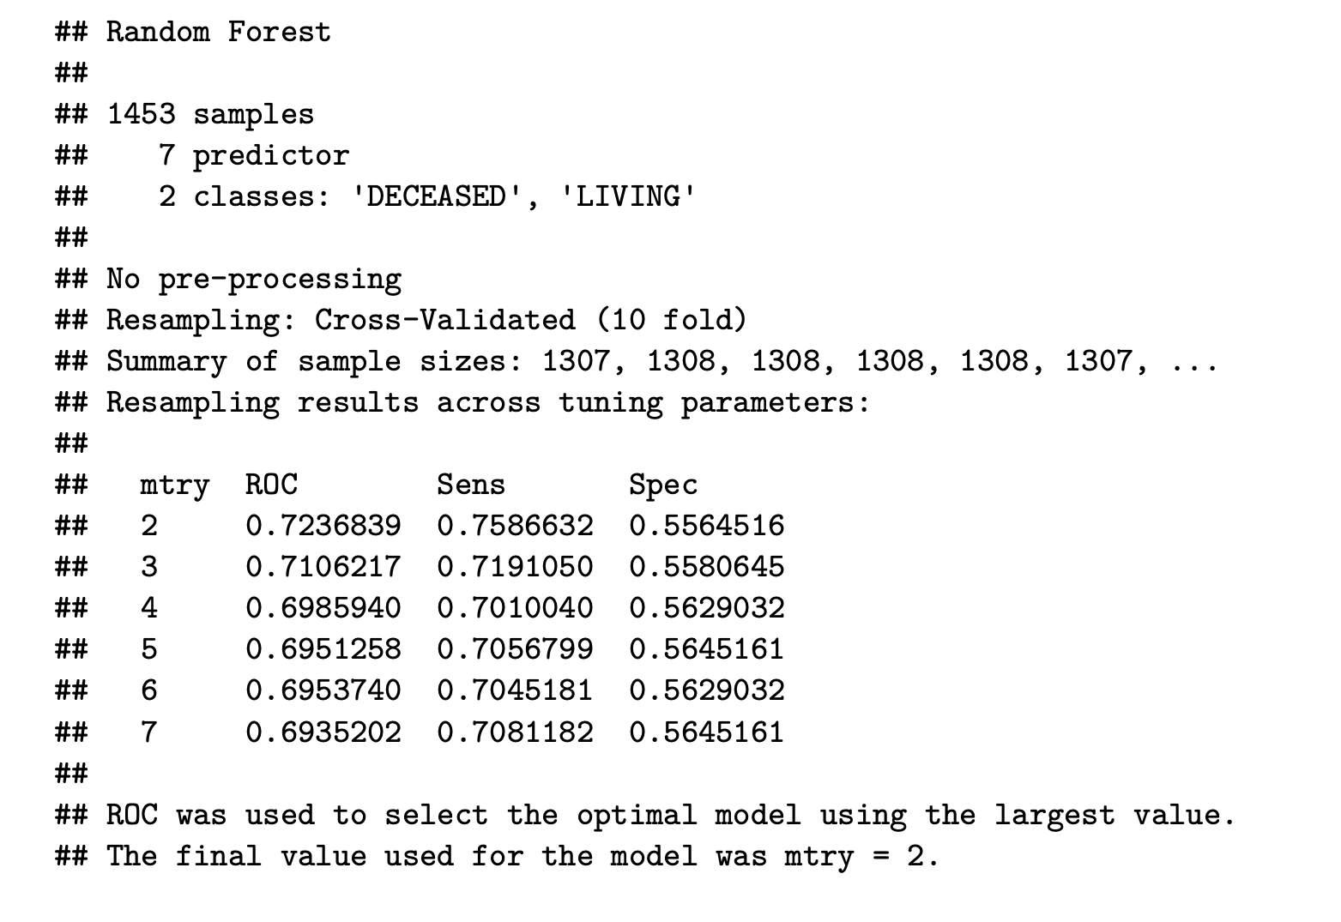
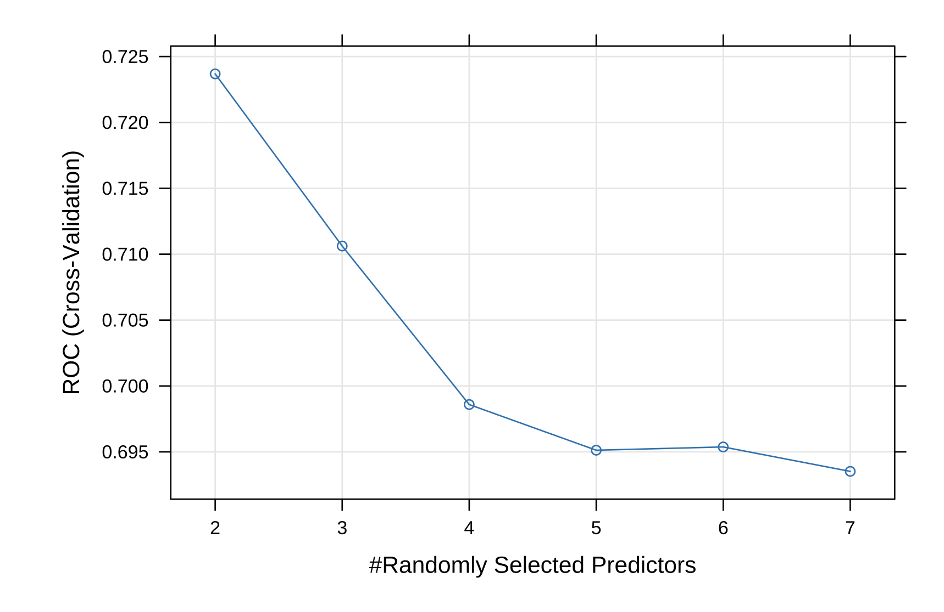
Random Forest Classifier:

Slide 13
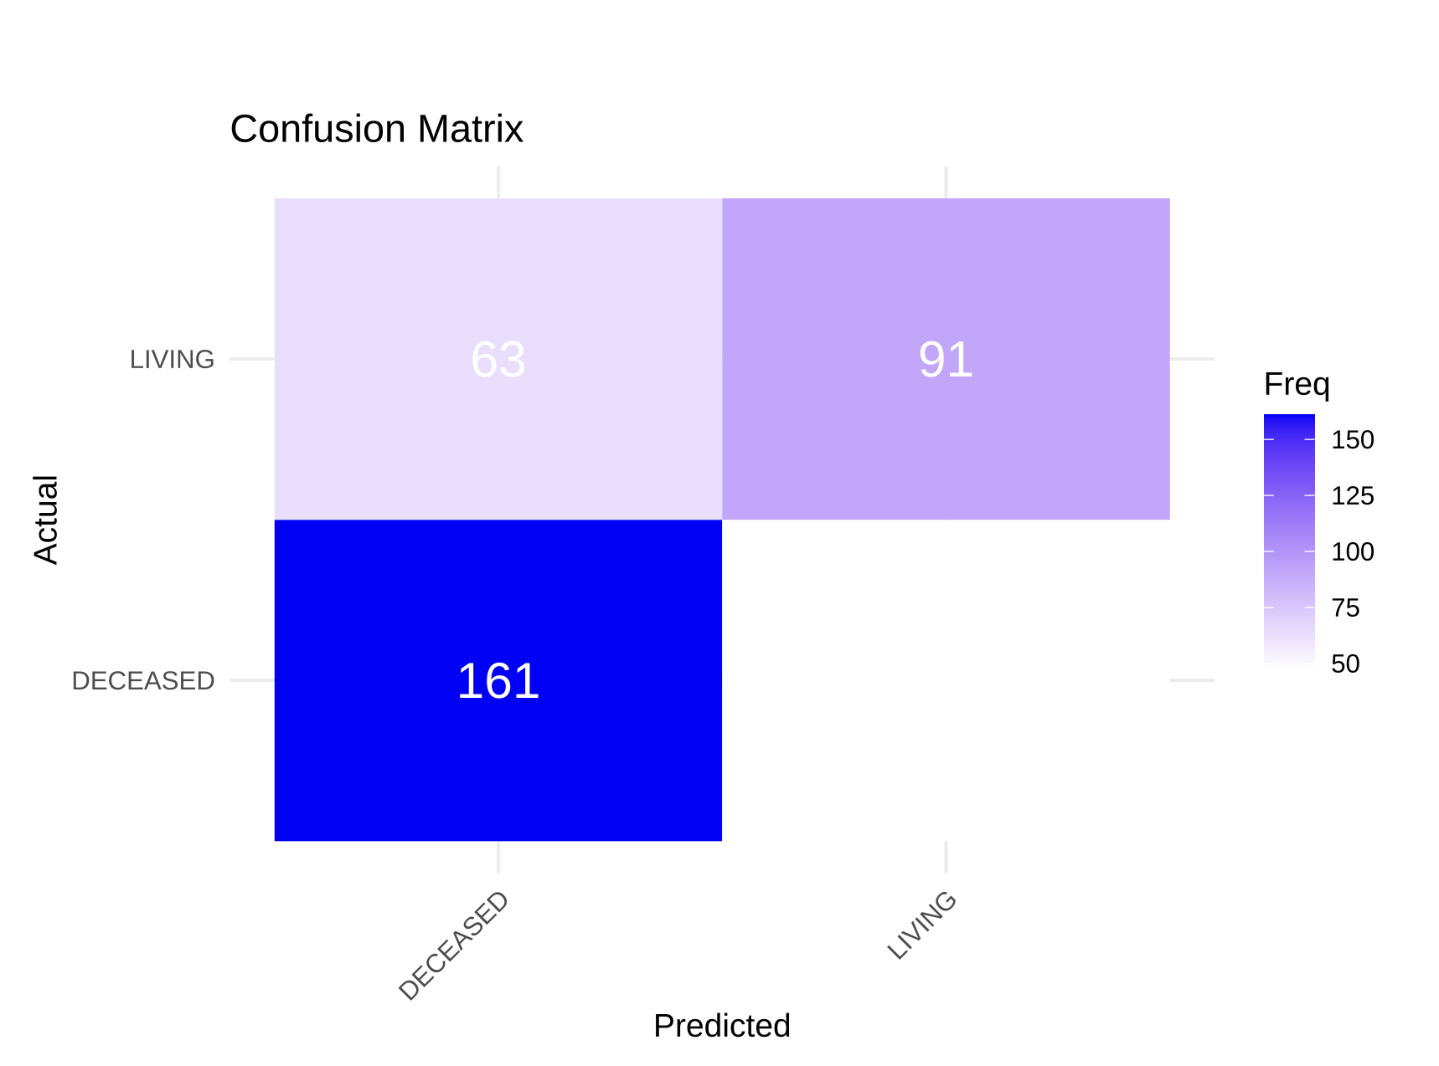
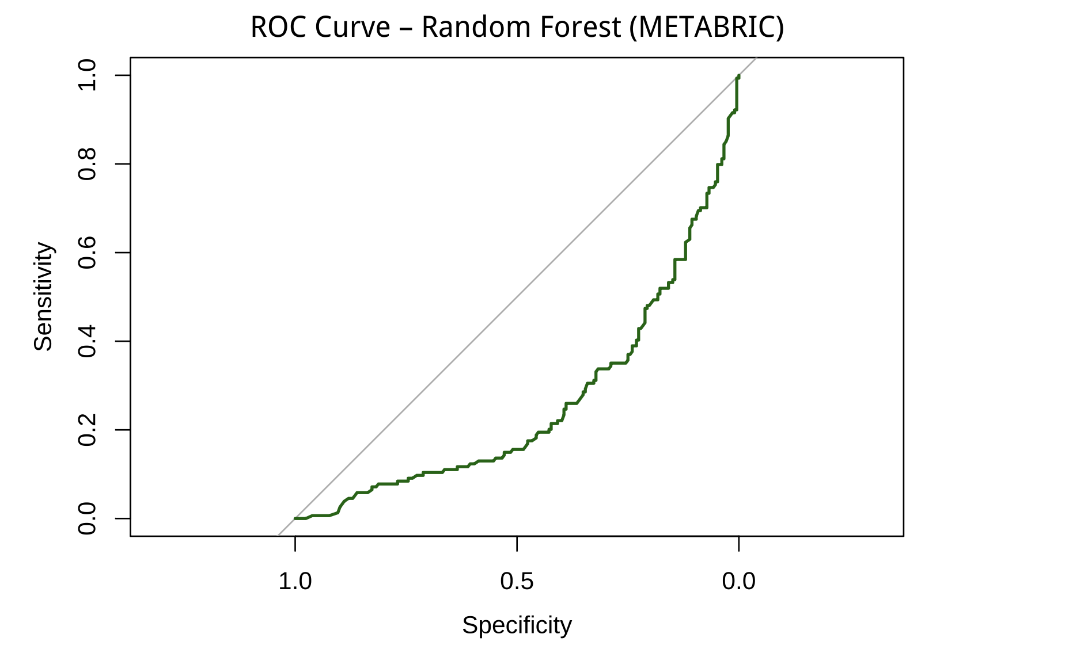
- Accuracy: 70.2%
- Sensitivity (Detecting DECEASED): 77.9%
- Specificity (Detecting LIVING): 59.7%
- Balanced Accuracy: 68.8%
Area under the curve: 0.2611

Slide 14
Conclusion:
Based on the evaluation metrics, the Random Forest classifier clearly outperformed the logistic regression model in predicting breast cancer survival status in the METABRIC dataset. Logistic regression showed very low accuracy (31%), poor sensitivity, and a negative Kappa value, indicating that it struggled to correctly classify both deceased and living patients. This suggests that the linear decision boundary assumed by logistic regression is not sufficient to capture the complex, nonlinear patterns present in the clinical data.
In contrast, the Random Forest model achieved a much higher accuracy (70%), with strong sensitivity (78%) and improved specificity (60%). Its balanced accuracy and Kappa values further demonstrate a substantially better fit. The model’s superior performance reflects its ability to account for nonlinear relationships and interactions among predictors—features that are common in biological and clinical datasets.

Slide 15
Thank you!!!

